Slide 1
uW Hackathon – 2024
Audio is a primary part of the human/computer interaction requried for Oral Bible Translation (OBT). And some Bible translation efforts target "low resource languages". As such, Bible translation software must understand spoken audio from low resource languages.
Thesis: Find a stable method for recognizing individual words in low-resource languages.
Here, we propose a model to recognize individual spoken words in Dholuo.
Definitions:
Here, "low resource languages" is understood as any language that does not have open, available models for LLM, speech-to-text, and text-to-speech.
By requiring a "stable" model, we require the solution to be independent of tone, volume, speed, or the speaker's gender.

Slide 2
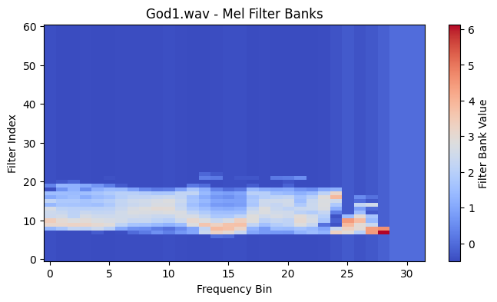
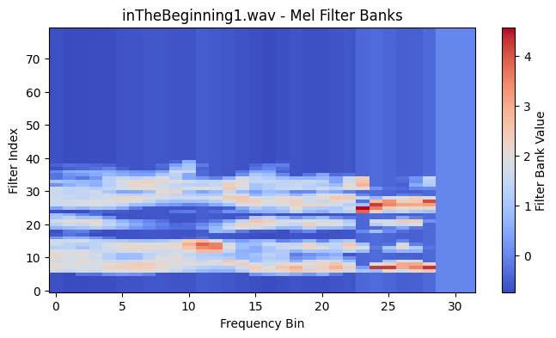
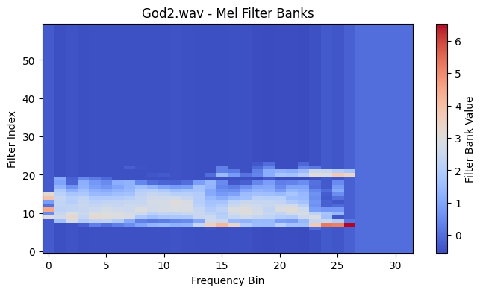
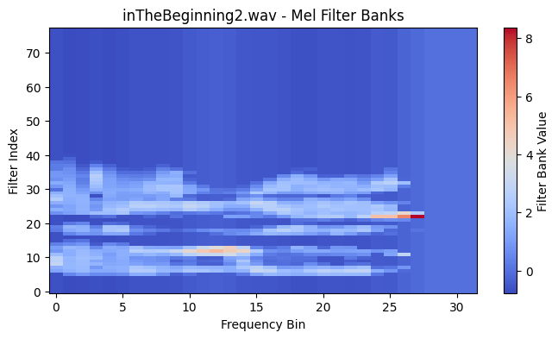

Slide 3
